Slide 1
Te Reo Māori Class 11 Week 13 (1 and 4 June)
Karakia/Waiata/Mihimihi
He Whakatauki / Kiiwaha
Pronunciation
He Korerorero: Conversation.
Karakia Whakamutunga:
Closing Prayer- Kia Tau

Slide 2
He hōnore, he korōria ki te Atua He maungārongo ki te whenua He whakaaro pai ki ngā tāngata katoa Hangā e te Atua he ngākau hou Ki roto, ki tēnā, ki tēnā o mātou Whakatōngia tō wairua tapu Hei awhina, hei tohutohu i ā mātou hei ako hoki i ngā mahi mō tēnei rā Amine.

Slide 3
Waiata He Hōnore E toru ngā mea
Tutira mai ngā Iwi

Slide 4
E toru ngā mea…There are three important things… E toru ngā mea (echo) Ngā mea nunui (echo) E kii ana (echo) Te Paipera (echo) Whakapono (echo) Tumanako (echo) Ko te mea nui (echo) Ko te AROHA…anō…

Slide 5
He whakatauki: He aroha whakatō He aroha puta mai. If kindness is sown,then kindness is received. He kiiwaha: Tūhia ki te rae! Write in on your forehead!

Slide 6
Ngā rā o te wiki: Days of the week. Rāhina Rātu Raapa Rāpare Rāmere Rāhoroi Rātapu, Rātapu Anei ngā rā o te wiki nei e… Sung to the tune of the banana boat song.

Slide 7
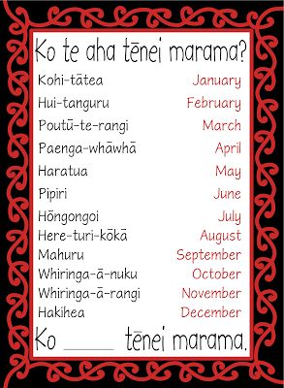
Ngā marama o te tau; Months of the year.

Slide 10
Ngā Wāhanaga o te tinana. Parts of the Body… Upoko / Mahunga Pakahiwi Puku Hope Waewae x 3 Taringa Whatu Ihu Waha e… anō

Slide 11
Kii mai Māori…

Slide 12
Whakarongo

Slide 13
He Kōrerorero – A Conversation. Tēnā koe! Ko wai tō ingoa? Kei te pēhea koe? Nō hea koe? Ko wai tō ingoa whānau? Ko wai tō whaea me tō pāpā? Nō hea rāua? Tokohia ngā tamariki i tō whānau? I whānau mai koe ki hea? Ko koe te mātāmua? Kei hea koe e noho ana? Kei hea tērā? Oh… I tipu ake koe ki ____ hoki? He aha ngā mea pai ki a koe? He pai ki a koe i te tiakareti?

Slide 14
Kiiwaha E kii, e kii… Kia tau! He rawe! Ka nui te pai! Ka pai Ne…ne rā… Ka mau te wehi Aroha mai Karawhiua!

Slide 15
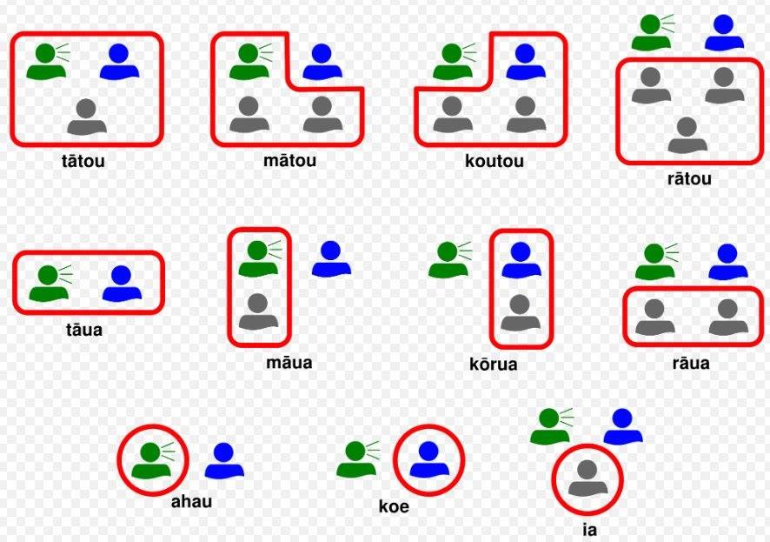

Slide 16
Using Dual and Plural Pronouns as a subject. Q1- I whanau mai kōrua / koutou ki hea? Where were you two / you all born? A1- I whanau mai māua / mātou ki ____________ We two / We all were born in ________________

Slide 17
Using Dual and Plural Pronouns as a subject. Q2 - I tipu ake rāua / rātou ki hea? Where did they two / they all grow up? A2 – I tipu ake rāua / rātou ki ________________ They two / they all grew up in______________

Slide 18
Using Dual and Plural Pronouns as a subject. Q2 - I tipu ake tāua / tātou ki hea? Where did us two / us all grow up? A2 – I tipu ake tāua / tātou ki ________________ Us two / us all grew up in______________

Slide 19
Ka Waiata

Slide 20
Karakia Whakamutunga

