Slide 1
Te Reo Māori Class 5 Week 7 (13 and 16 April)
Karakia/Waiata/Mihimihi
He Whakatauki / Kiiwaha
He Kōrerorero – Waiata, Whanaungatanga, Pepehā, Arotake, Aromatawai, Karakia.
He Pakiwaitara – Translation exercise.
Karakia Whakamutunga: Closing Prayer- Kia Tau

Slide 2
E to mātou Matua i te rangi Kia tapu tōu Ingoa Kia tae mai tōu rangatira-tanga. Kia meatia tau e pai ai ki runga ki te whenua, kia rite anō ki tō te rangi. | Our Heavenly Father Holy is your Name Your Kingdom come; Your will be done on earth as in Heaven.
Homai ki a mātou aianei he taro mā mātou mō tēnei rā. Murua o mātou hara Me mātou hoki e muru nei I ō te hunga e hara ana ki a mātou. Aua hoki mātou e kawea kia whaka-waia; | Give us our food we need today. . Forgive our sins Father; As we forgive those who sin against us. Don’t lead us into temptation;
Engāri whaka-orangia mātou, i te kino: Nōu hoki te rangatira-tanga, te kaha, me te kororia, Ake, ake, ake. Amine. | Keep us from evil; For yours is the Kingdom, yours is the power and the glory. Forever and ever Amen

Slide 5
Whakatauki: Kaua e wareware, he rā anō apōpō. Don’t forget tomorrow is another day.
Kiiwaha: Karawhiua!
Give it your all!

Slide 6
Dual Vowel Sounds ae ai ao au ā āe āo āī āu ea ei eo eu ē ēa ēi ēo ia ie io iu ī īo īa īe īu oa oe oi ou ō ōa ōe ōi ōu

Slide 7
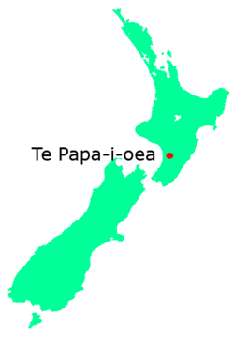
Place Names

Slide 8
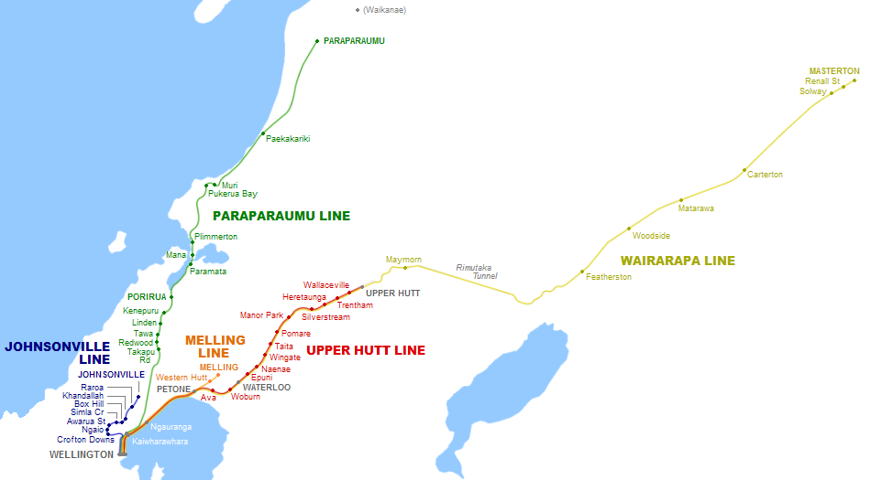

Slide 9
Ngā Wāhi Ingoa / Place Names
Tongariro Taumarunui Waipukurau
Ngaruawāhia Taupo Whanganui
Te Awamutu Whirinaki Ngā Urewera
Te Ika a Maui Te Waipounamu Muriwai
Te Moana nui a Kiwa Te Tai o Rehua Tasman Sea

Slide 11
Pepehā and Waiata Tautoko Presentation. Everyone ready to share? If not, then next week we can finish sharing our pepehā and waiata tautoko.

Slide 12
Waiata – Kii mai Māori KAEA: Hope, Ki raro, Hope…toru whā Kii mai Māori kii mai A x3, Kii mai Māori kii mai E x3 Kii mai Māori kii mai I x3, Kii mai Māori kii mai O x3 Kii mai Māori kii mai U x3 (Repeat anō- long vowel sounds stepping forward) Kii mai Māori kii mai Ā x3, Kii mai Māori kii mai Ē x3 Kii mai Māori kii mai Ī x3, Kii mai Māori kii mai Ō x3 Kii mai Māori kii mai Ū (Close your eyes) x3. KAEA: Hope, Ki raro.

Slide 13
Tēnei = this by me
Tēnā = that by you
Tērā = that over there beyond the both of us.
Often in te reo Māori when speaking about the plural of something other than “te” which means “the” (singular) or “ngā” which also means “the” (plural). Often we drop the “t” for example…
Tōku = my (singular) and ōku = my (plural).
Tō / tōu = your (singular) and ō / ōu = my (plural).
Tōnā = his or her (singular)and ōnā = his or hers (plural).

Slide 14
Who is this? Who is that? Who are these/those ? Ko + wai + tēnei? Ko + name of person or place + tēnei/tēnā/tērā? What is this? What is that? What are these/those? He + aha + tēnei? He + thing or object + tēnei/tēnā/ tērā.

Slide 15
Again dropping the “t” to denote plurality. Tēnei becomes ēnei = these by me. Tēnā becomes ēnā = those by you (beyond au or beyond me by you.) Tērā becomes ērā = those over there beyond the both of us ( beyond au and koe)

Slide 16
Mahi Kāinga – Homework Wk 4 Write ten sentences using all of these tēnei, tēnā, tērā and ēnei, ēnā and ērā and your kupu hou. Whakapākehātia ngā rārangi kōrero. Translate the sentences. Student’s share… Break Out into groups

Slide 17
Kupu Hou – How many words do you know from last week 4?
Pukapuka waiata
Pene haka / kanikani -
Waea pūkoro whare
Naihi – waka
Paoka – paihikara
Pereti – peke
Tūru – pōtae –
Tēpu – poro –
Ipu – kānohi kē -
Karaihe – karapu -

Slide 18
Whakapākehātia i ēnei pakiwaitara.

Slide 19
He Pakiwaitara – A Story. Kupu Awhina mō – for, about ahakoa- despite aue! Alas indeed! mirumiru – bubble whakapākehātia – translate to English
He pakiwaitara tēnei. He pakiwaitara tēnei mō tōku whanau.
Ko Tana tōku ingoa whānau. Ko Tere Tana tōku ingoa.
Nō Paraparaumu ahau. Nō Paraparaumu tōku whānau.
Nō hea koe? Nō hea tō whānau?
Kei te pai te whānau ahakoa te Covid19! Aue!
Kei te kāinga tōku whanau e noho ana i te mirumiru.

Slide 20
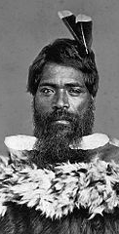
Ko wai tō whānau? Ko Tutanekai tōku pāpā. Ko Tutanekai tōku whānau. Ko wai tēnei? Ko Tutanekai tēnā. Ko wai ia? Ko Tutanekai tērā. He aha a ia? What is he? He tane a Tutanekai. He tane ia, he tane tērā.

Slide 21
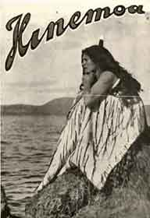
Nō hea tō whānau? Nō Rotorua tōku whānau. Nō hea tō māmā. Nō Tāmaki makaurau ia. Nō hea tō pāpā? Nō Rotorua. Nō hea koe? Aua hoki! Aua hoki? Ka aroha hoki…Oh sorry…
This Photo by Unknown Author is licensed under CC BY-SA

Slide 22
He pakiwaitara - A story about Hinemoa. Hello to you all! Hinemoa is my name. I am a woman from Tāmakimakaurau. I am Tutanekai’s wife. I am well. Tutanekai is my husband. He is a man from Rotorua. His family are from Rotorua. He is tired. I am his family. Aroha is our family name. This is Tama and that is Riana. Tama is my family. What is your family name? How are your family? Where are you from? Where are your family from? Excellent! Greetings to you all!

Slide 23
He pakiwaitara - A story about Hinemoa. Tēnā koutou katoa!Hello to you all!Kia ora koutou katoa! Hinemoa is my name. Ko Hinemoa tōku ingoa. I am a woman from Tāmakimakaurau. He wahine nō Tāmakimakaurau. I am Tutanekai’s wife. Ko au te hoa rangatira o Tutanekai. I am well. Kei te pai au. Tutanekai is my husband. Ko Tutanekai tōku hoa rangatira. He is a man from Rotorua. He tane nō Rotorua. His family are from Rotorua. Ko tōnā whānau nō Rotorua. He is tired. Kei te ngenge ia. I am his family. Ko au tōnā whānau. Aroha is our family name. Ko Aroha te ingoa whanau. This is Tama and that is Riana. Ko Tama tēnei, Ko Rīana tēnā/tērā. Tama is my family. Ko Tama tōku whānau. What is your family name? Ko wai tō ingoa whānau? How are your family? Kei te pēhea tō whānau? Where are you from? Nō hea koe? Where are your family from? Nō hea tō whānau? Excellent! Rawe! Greetings to you all!

Slide 24
Karakia Whakamutunga.(Closing Prayer) Kia tau kia tātou katoa Te atawhai ō tō tātou Ariki, a Ihu Karaiti Me te aroha o te Atua Me te whiwhingatahitanga ki te Wairua Tapu. Ake ake ake, Amine.

