Slide 1
Te Reo Māori Class 8 Week 10 (1 and 4 May)
Karakia/Waiata/Mihimihi
He Whakatauki / Kiiwaha
Pronunciation
Asking Where do you live and Where are you working?
Counting: Asking How many?
How many things, how many people?
How old are you?
Days of the Week and Months
Karakia Whakamutunga: Closing Prayer- Kia Tau

Slide 2
He hōnore, he korōria ki te Atua He maungārongo ki te whenua He whakaaro pai ki ngā tāngata katoa Hangā e te Atua he ngākau hou Ki roto, ki tēnā, ki tēnā o mātou Whakatōngia tō wairua tapu Hei awhina, hei tohutohu i ā mātou hei ako hoki i ngā mahi mō tēnei rā Amine.

Slide 5
He whakatauki: Ahakoa he iti he pounamu. Although it may be small, it is a treasure. He kiiwaha: Ka wāni kē! = WOW!!

Slide 7
How do we ask “ Where are you living?”
Kei hea koe e noho ana?
Kei + Place or place name + subject + e noho ana
Kei hea koe e noho ana?
Where are you living?
Kei + Tāmakimakaurau + ahau + e noho ana
I am living in Auckland.

Slide 8
Kei hea a Jody e noho ana? Kei hea te wahine e noho ana?
This Photo by Unknown Author is licensed under CC BY-SA-NC
This Photo by Unknown Author is licensed under CC BY-SA

Slide 9
Kei hea ia e noho ana? Kei _________________ia e noho ana.

Slide 10
How do we ask, “ Where are you working?” Kei hea koe e mahi ana? Kei+Place or place name + subject + e mahi ana Kei hea koe e mahi ana? Where are you working? Kei + Makitānara + ahau + e mahi ana I am working at McDonalds.

Slide 11
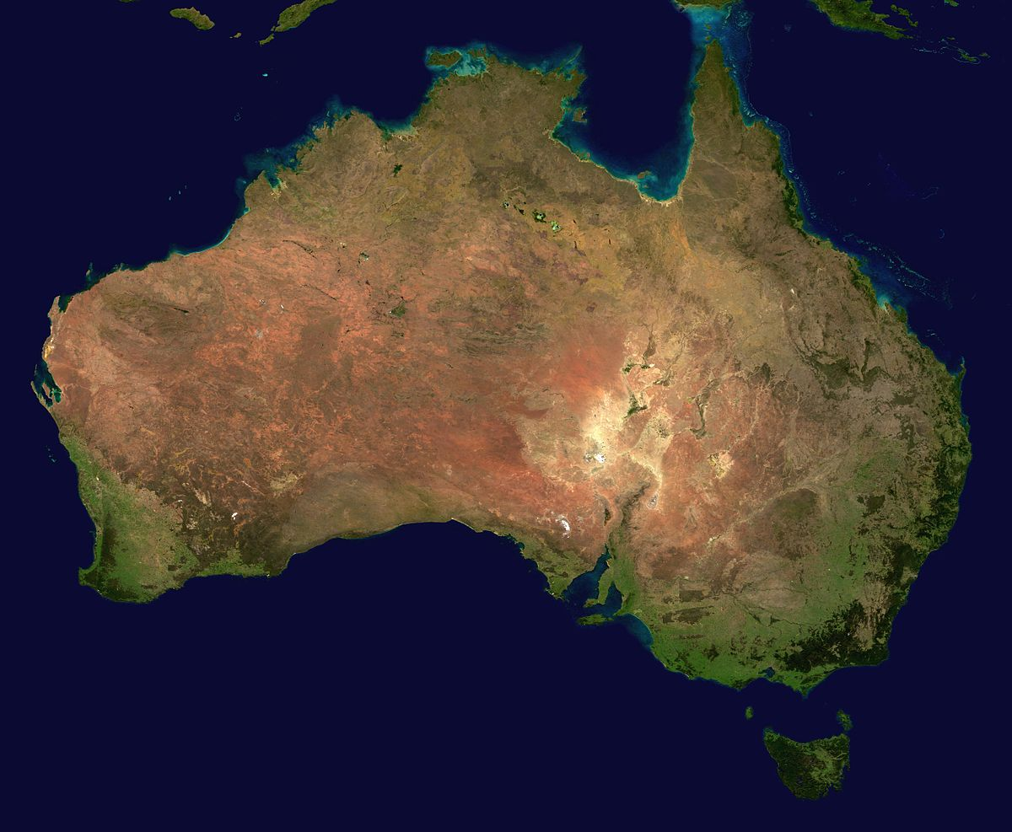
Kei hea a Jill e mahi ana?
Change the place / place name, the subject – person or people, the activity and what else can we communicate using this sentence structure?
This Photo by Unknown Author is licensed under CC BY-SA
This Photo by Unknown Author is licensed under CC BY-SA
This Photo by Unknown Author is licensed under CC BY-SA

Slide 12
Counting – Te tatau. Recap – How many things? How many people? How young are you? How young is he/she? How young is Das? Counting numbers 2-9 and 20-99. Ordinal numbers tuatahi-1st, tuarua -2nd, tuatoru-3^{rd,} tuawhā – 4th, tuawhitu – 5th, tuaono – 6^{th, etc…}

Slide 13
Counting (10-100)
By now, you have learnt the numbers 1 through to 10. Learning the numbers 10 to 100 builds on the numbers you have learnt and as long as you know the numbers 1-10 then you will have little trouble with this work. Look at the following numbers below: Use E before 2 to 9 and 20 to 99. 10 tekau 16 tekau mā ono 17 tekau mā whitu 20 e rua tekau 21 e rua tekau mā tahi 22 e rua tekau mā rua 30 e toru tekau 37 e toru tekau mā whitu 49 e whā tekau mā iwa 54 e rima tekau mā whā 62 e ono tekau mā rua 71 e whitu tekau mā tahi 99 e iwa tekau mā iwa
100 kotahi rau

Slide 14
Ko te aha te rā o tō rā whanau?

Slide 15
How to communicate the day and date… Your birthday day and month and year 1900 – Kotahi mano =1000 iwa rau = 900 2000 = rua mano rua tekau = 20 Write the day of your birthday … Ko Rāhina te rā tekau mā waru o Pīpiri, Kotahi mano iwa rau ono tekau mā whitu

Slide 16
13 (ia - 3rd person) 24 Hoani 79 102 10 (ia – 3rd person) Write these numbers in Māori. Say them in Māori. Ask how old some one is in Māori and respond. Ask how many people there are and respond.

Slide 17
Ngā rā o te wiki: Days of the week. Rāhina Rātu Raapa Rāpare Rāmere Rāhoroi Rātapu, Rātapu Anei ngā rā o te wiki nei e… Sung to the tune of the banana boat song.

Slide 18
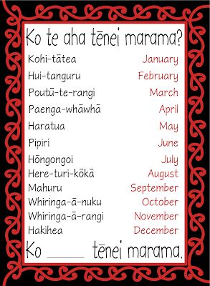
Ngā marama o te tau; Months of the year.

Slide 19
Ko Rāhina te rā tuatahi o Hākihea. Ko Rātapu te rā whare karakia. Ko Raapa te rā toru tekau mā rua o Paengawhāwhā Ko Rāmere te rā tekau mā toru o … Ko Rāhoroi te rā tuarua o Pipiri. Ko Rāhina te pō tekau mā tahi o Haratua. Ko te aha te rā o tō rā whanau? What day is your birthday?

Slide 20
He Kōrerorero…A Conversation Greeting Who are you ? How are you? Where are you from? Where are you living? Where are you working? Who are your family? How many people in your family? Where were you born? Where were you raised? What kind of things do you like? Greeting then Farewell.

Slide 22
Karakia Whakamutunga

