Slide 1
Te Reo Māori Class 8 Week 10 (1 and 4 May)
Karakia/Waiata/Mihimihi
He Whakatauki / Kiiwaha
Pronunciation
Asking Where do you live and Where are you working?
Counting: Asking How many?
How many things, how many people?
How old are you?
Days of the Week and Months
Karakia Whakamutunga: Closing Prayer- Kia Tau

Slide 2
He hōnore, he korōria ki te Atua He maungārongo ki te whenua He whakaaro pai ki ngā tāngata katoa Hangā e te Atua he ngākau hou Ki roto, ki tēnā, ki tēnā o mātou Whakatōngia tō wairua tapu Hei awhina, hei tohutohu i ā mātou hei ako hoki i ngā mahi mō tēnei rā Amine.

Slide 5
He whakatauki: Ahakoa he iti he pounamu. Although it may be small, it is a treasure. He kiiwaha: Ka wāni kē! = WOW!!

Slide 8
Vowel Song – Piata piata ngā whetu-Twinkle twinkle
 | a | e | i | o | u
a | aa | ae | ai | ao | au
e | ea | ee | ei | eo | eu
i | ia | ie | ii | io | iu
o | oa | oe | oi | oo | ou
u | ua | ue | ui | uo | uu

Slide 9
How do we ask “ Where are you living?”
Kei hea koe e noho ana?
Kei + Place or place name + subject + e noho ana
Kei hea koe e noho ana?
Where are you living?
Kei + Tāmakimakaurau + ahau + e noho ana
I am living in Auckland.

Slide 10
Kei hea a Jody e noho ana? Kei hea te wahine e noho ana?
This Photo by Unknown Author is licensed under CC BY-SA-NC
This Photo by Unknown Author is licensed under CC BY-SA

Slide 11
Kei hea ia e noho ana? Kei _________________ia e noho ana.

Slide 12
How do we ask, “ Where are you working?” Kei hea koe e mahi ana? Kei+Place or place name + subject + e mahi ana Kei hea koe e mahi ana? Where are you working? Kei + Makitānara + ahau + e mahi ana I am working at McDonalds.

Slide 13
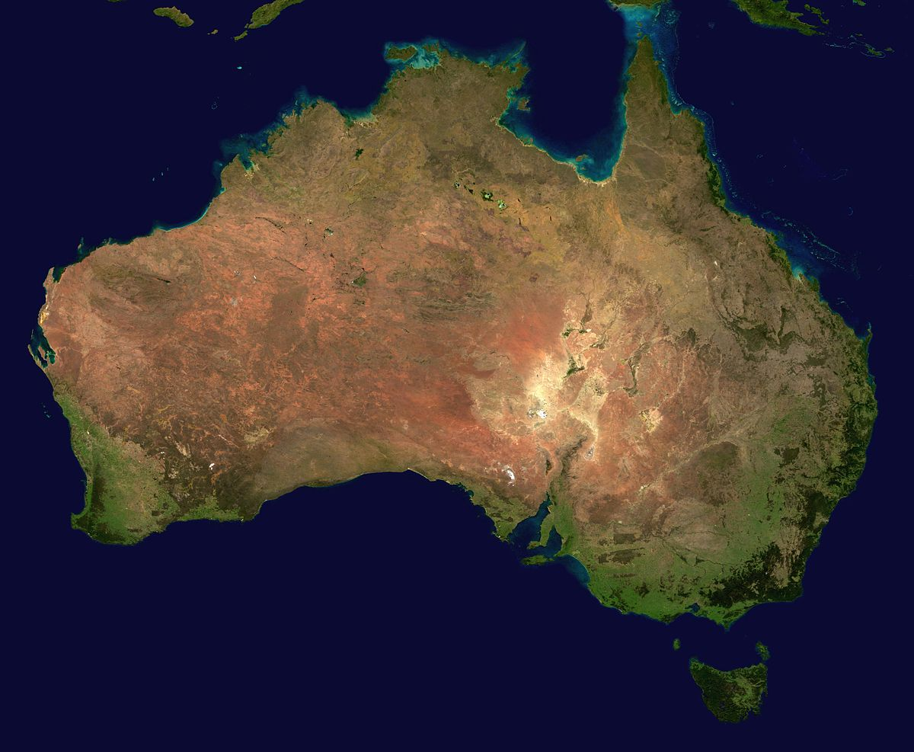
Kei hea a Jill e mahi ana?
Change the place / place name, the subject – person or people, the activity and what else can we communicate using this sentence structure?
This Photo by Unknown Author is licensed under CC BY-SA
This Photo by Unknown Author is licensed under CC BY-SA
This Photo by Unknown Author is licensed under CC BY-SA

Slide 14
Counting – Te tatau. Recap – How many things? How many people? How young are you? How young is he/she? How young is Das? Counting numbers 2-9 and 20-99. Ordinal numbers tuatahi-1st, tuarua -2nd, tuatoru-3^{rd,} tuawhā – 4th, tuawhitu – 5th, tuaono – 6^{th, etc…}

Slide 15
Counting (10-100)
By now, you have learnt the numbers 1 through to 10. Learning the numbers 10 to 100 builds on the numbers you have learnt and as long as you know the numbers 1-10 then you will have little trouble with this work. Look at the following numbers below: Use E before 2 to 9 and 20 to 99. 10 tekau 16 tekau mā ono 17 tekau mā whitu 20 e rua tekau 21 e rua tekau mā tahi 22 e rua tekau mā rua 30 e toru tekau 37 e toru tekau mā whitu 49 e whā tekau mā iwa 54 e rima tekau mā whā 62 e ono tekau mā rua 71 e whitu tekau mā tahi 99 e iwa tekau mā iwa
100 kotahi rau

Slide 16
How to communicate the day and date…

Slide 17
Ngā rā o te wiki: Days of the week. Rāhina Rātu Raapa Rāpare Rāmere Rāhoroi Rātapu, Rātapu Anei ngā rā o te wiki nei e… Sung to the tune of the banana boat song.

Slide 18
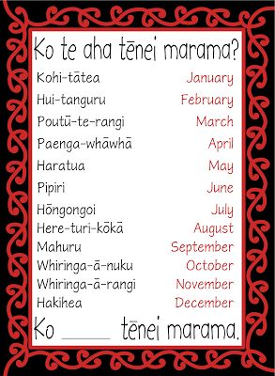
Ngā marama o te tau; Months of the year.

Slide 19
Ko Rāhina te rā tuawhā o Mei. Ko Rātapu te rā whare karakia. Ko Raapa te rā rua tekau mā tahi o Paengawhāwhā Ko Rāmere te rā tekau mā toru o … Ko Rāhoroi te rā tuarua o Pipiri. Ko Rātu te pō tuaono o te wiki. Ko te aha te rā o tō rā whanau? What day is your birthday?

Slide 20
Ko te aha te rā o tō rā whanau?

Slide 22
Karakia Whakamutunga

